Slide 1
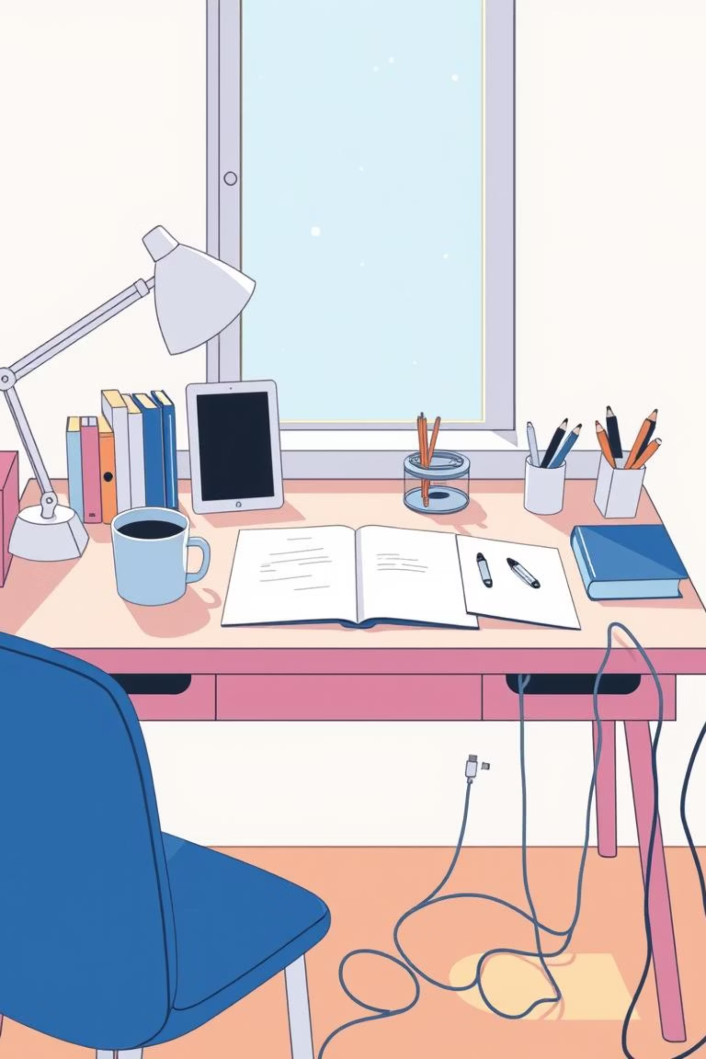
Everyday Innovation:
Making Life Easier, One Idea at a Time
Group Members:
Phurten
Sarah
Peng Cheng
Ripal

Slide 2
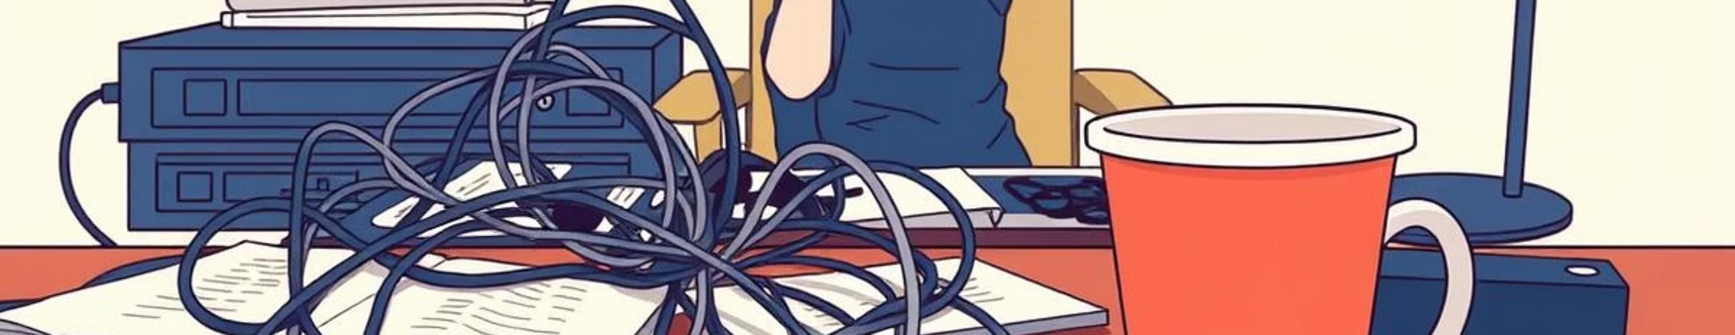
The Problem: Everyday Stressors
Losing keys every morning
Tangled charging cables
Coffee line = nightmare
Daily stress adds up!

Slide 3
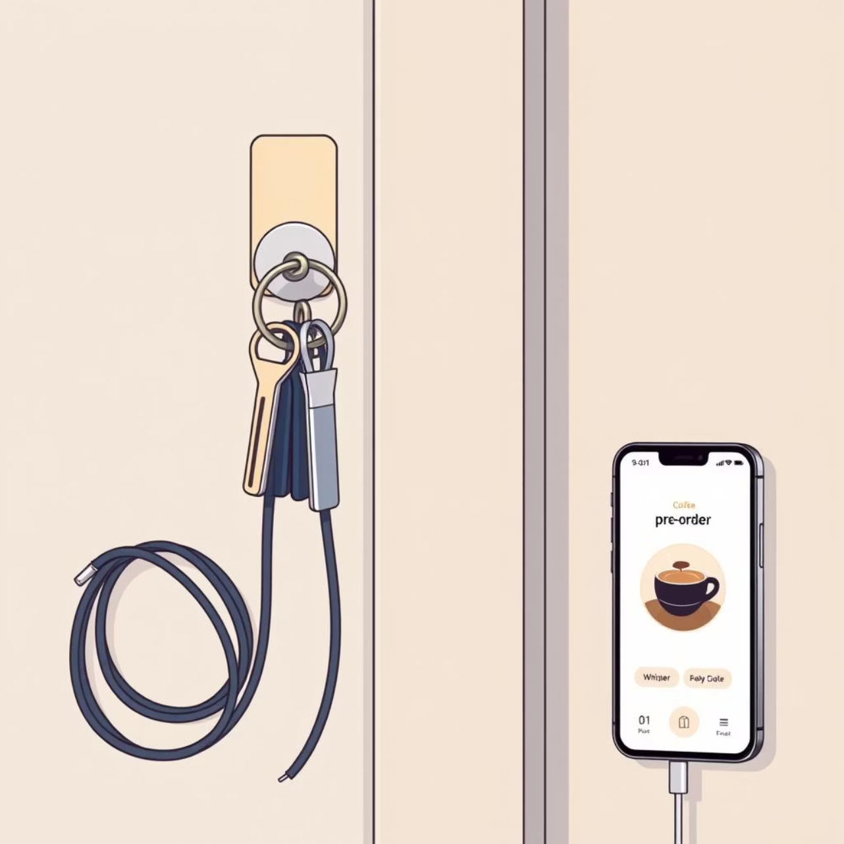
Our Simple, Smart Solutions
Magnetic key holder: never lose your keys again
Retractable cables: tangle-free charging
Coffee pre-order app: skip the line, grab & go
Simple → Smart → Stress-free mornings

Slide 4

Why These Innovations Matter
Saves time, money, sanity
10 minutes saved = more sleep
Cheap fixes, big impact
Life feels more efficient

Slide 5
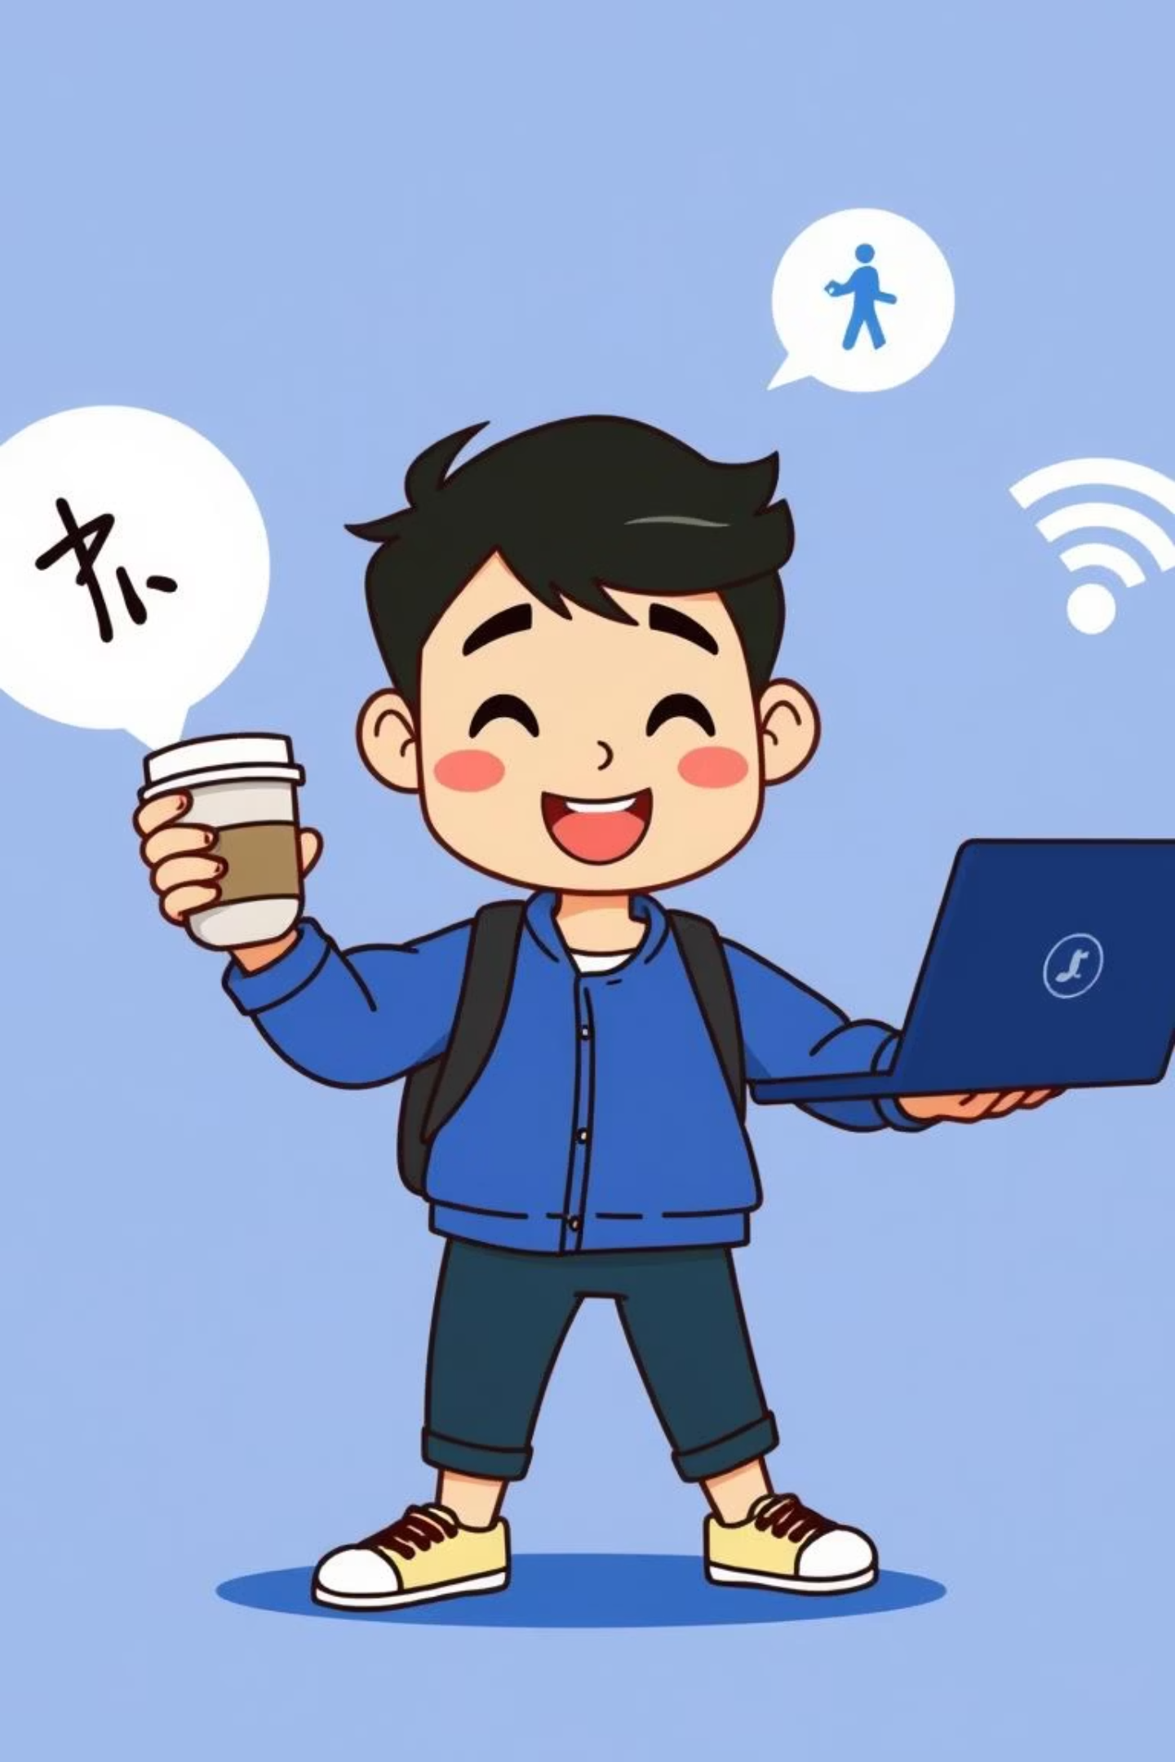
Humor: The Student’s Life Juggling Act
Students = jugglers of life
Coffee ☕ + Laptop 💻 + WiFi 🙏
Innovations = better juggling tools
Look like we’ve got life together (even if we don’t)

Slide 6


Everyday Innovation = Stress Less, Live More
Not about flying cars 🚗💨
Just simple, smart, funny fixes
Making everyday life a little less chaotic

